Slide 1

SSID: WWCode
Password: password
Notes:
Please remove this slide when sharing the document to the public

Slide 2
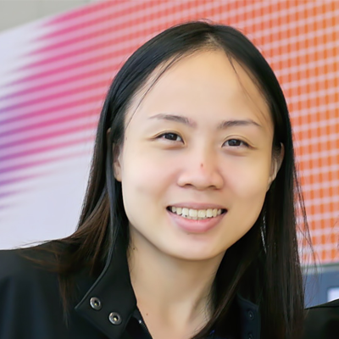

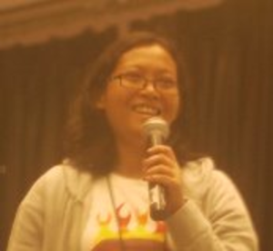

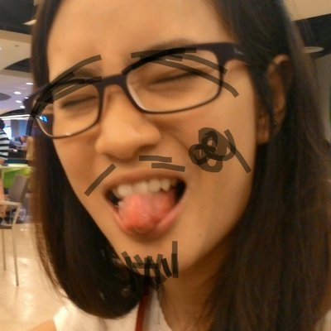
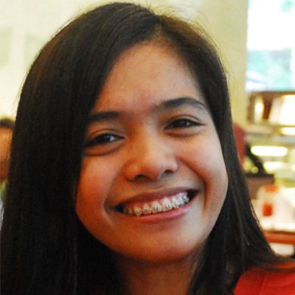

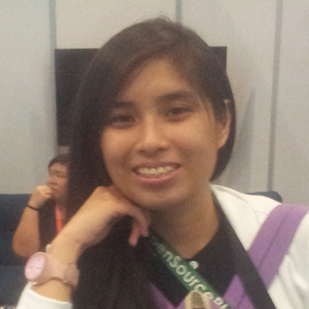
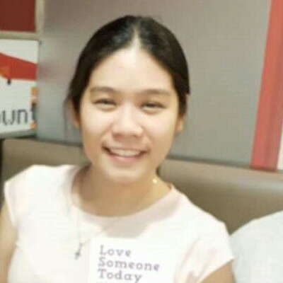

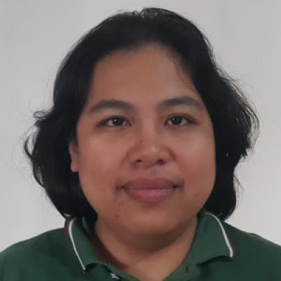
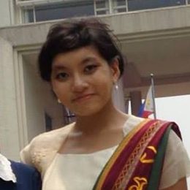
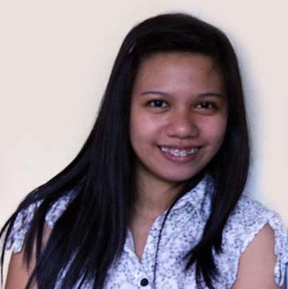
ML and AI Study Group
Twitter: @wwcodemanila
FB: fb.com/wwcodemanila
#WWCodeManila
#YourProgrammingLanguage
#StudyGroup

Slide 3
Issa
Research Fellow
PCARI
Notes:
Please use only the three colors for the content.

Slide 4
New Member’s Introduction

Slide 5

I am <name>
<your current profession>
<why did you join this study group?>
Notes:
Please use only the three colors for the content.

Slide 6
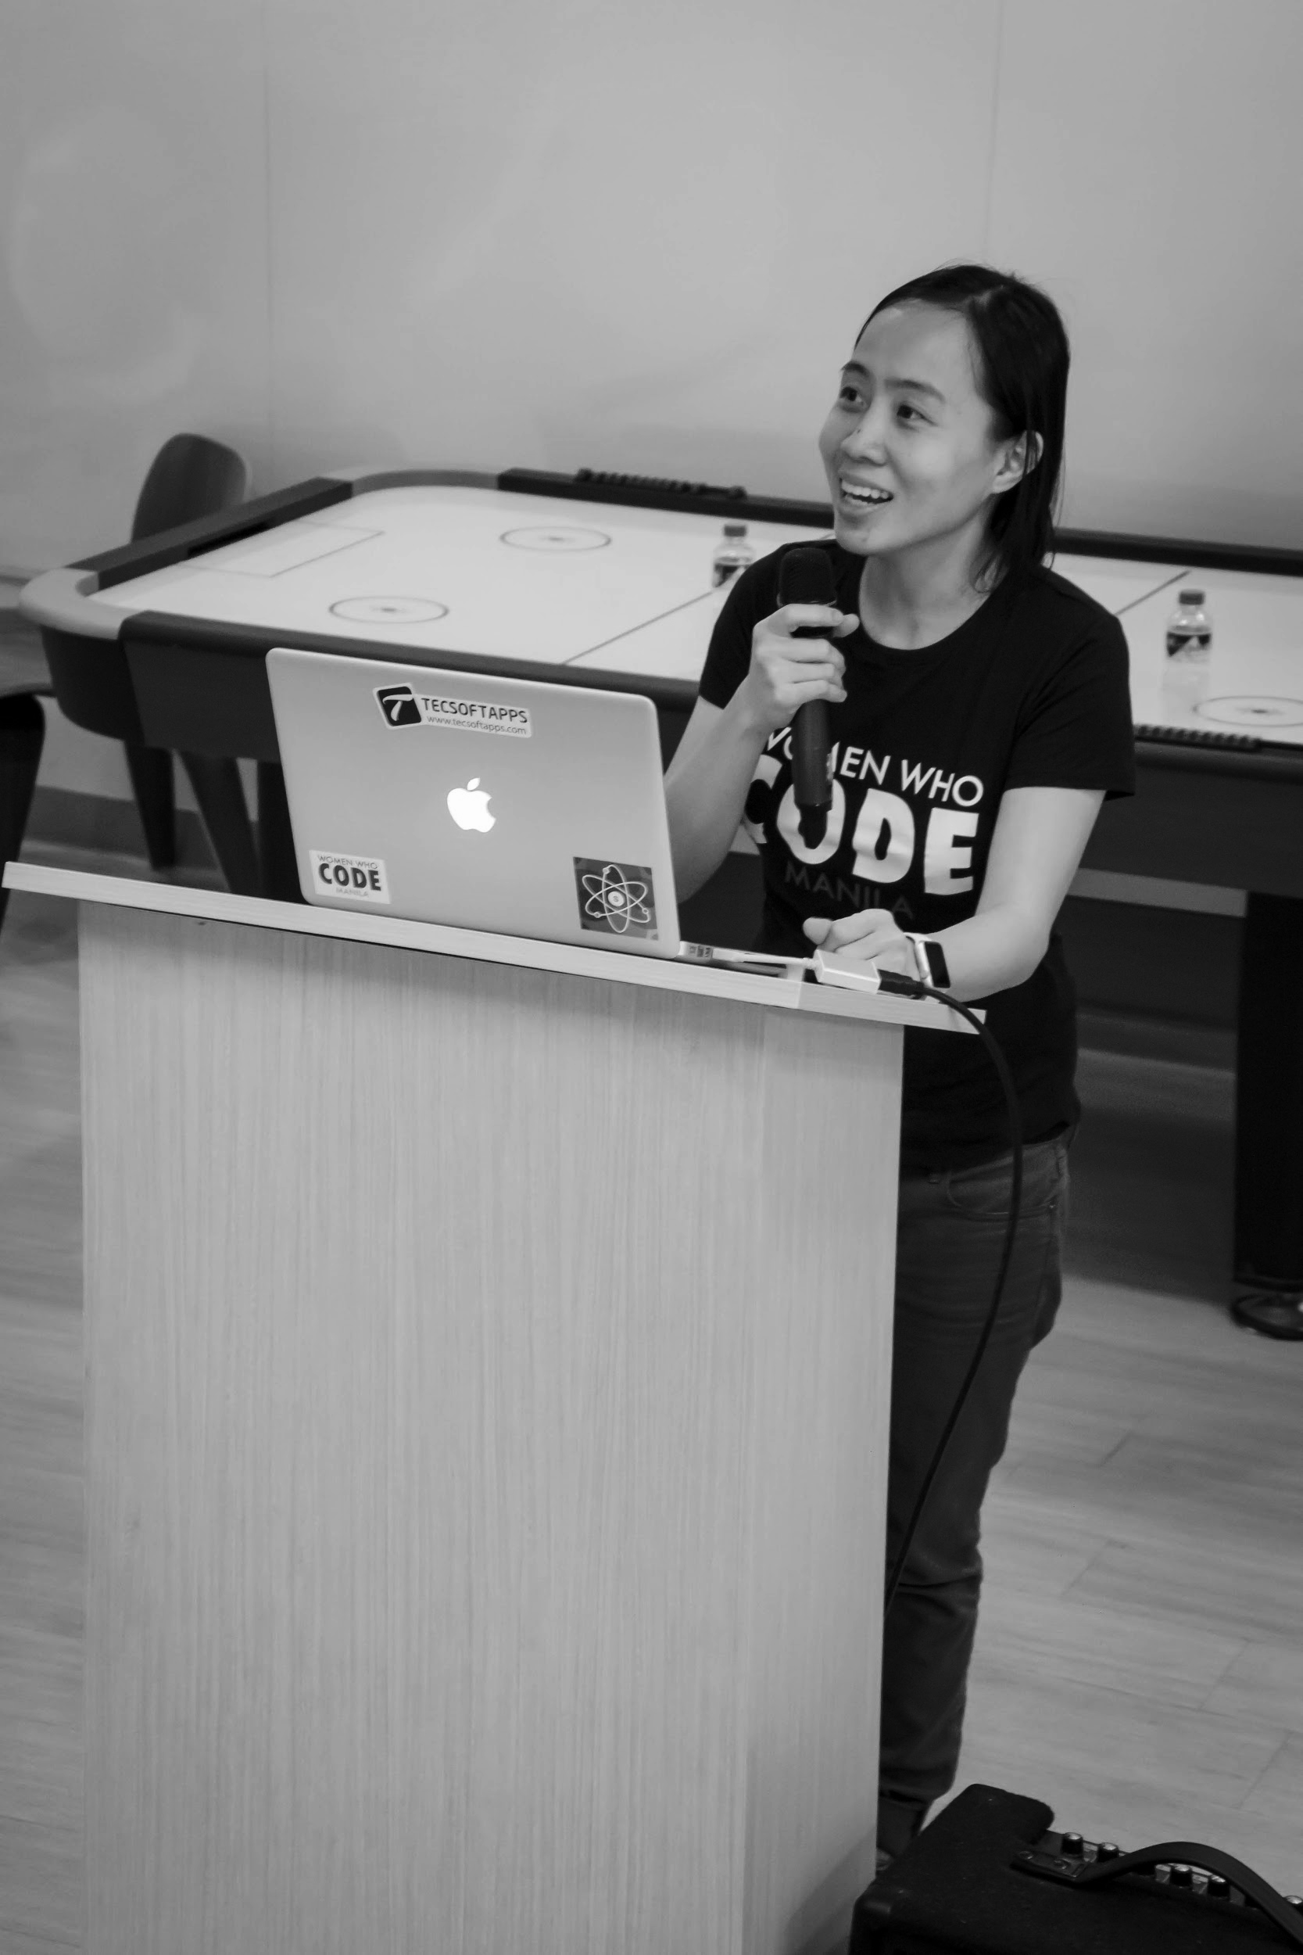

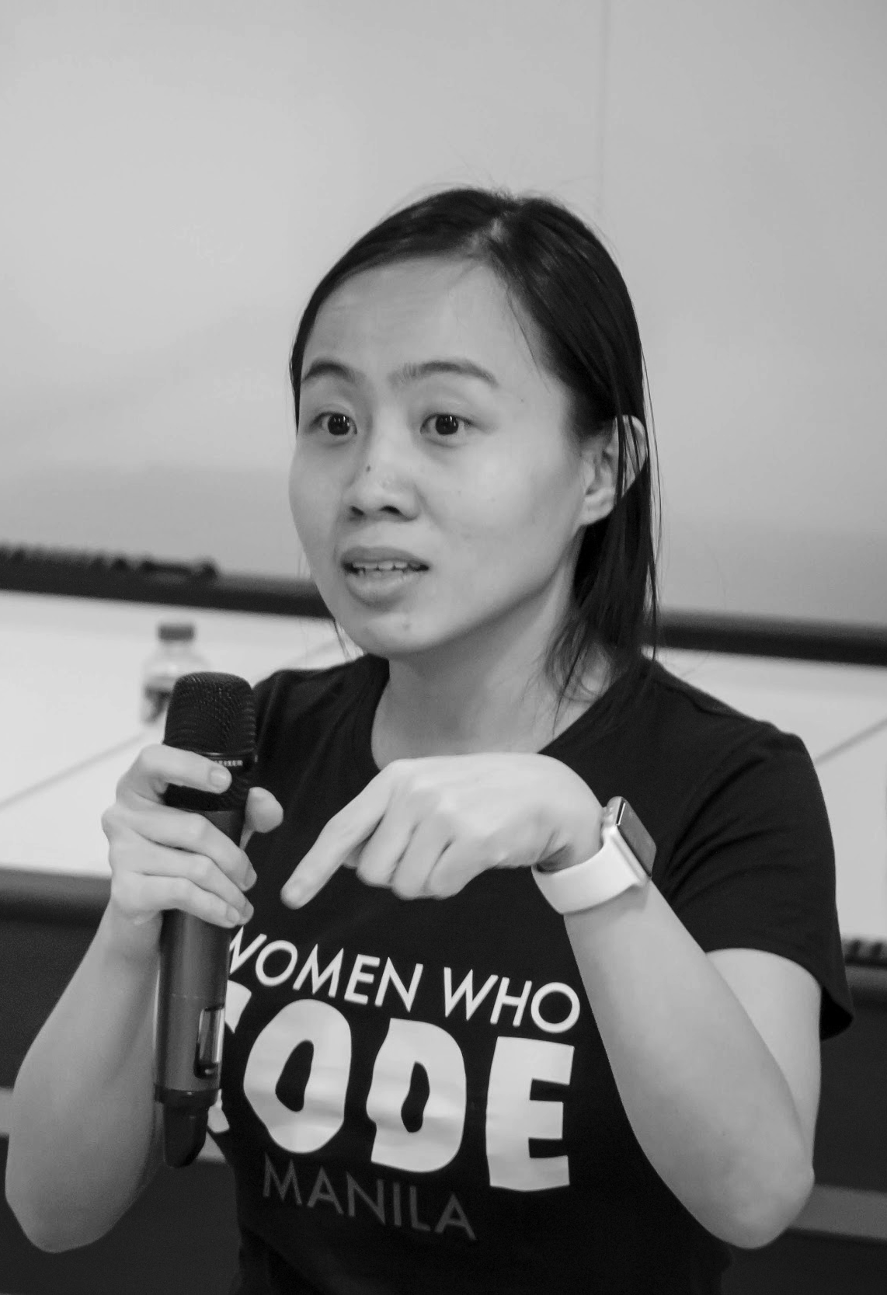
OUR MISSION
Inspiring women to excel in technology careers.

Slide 7
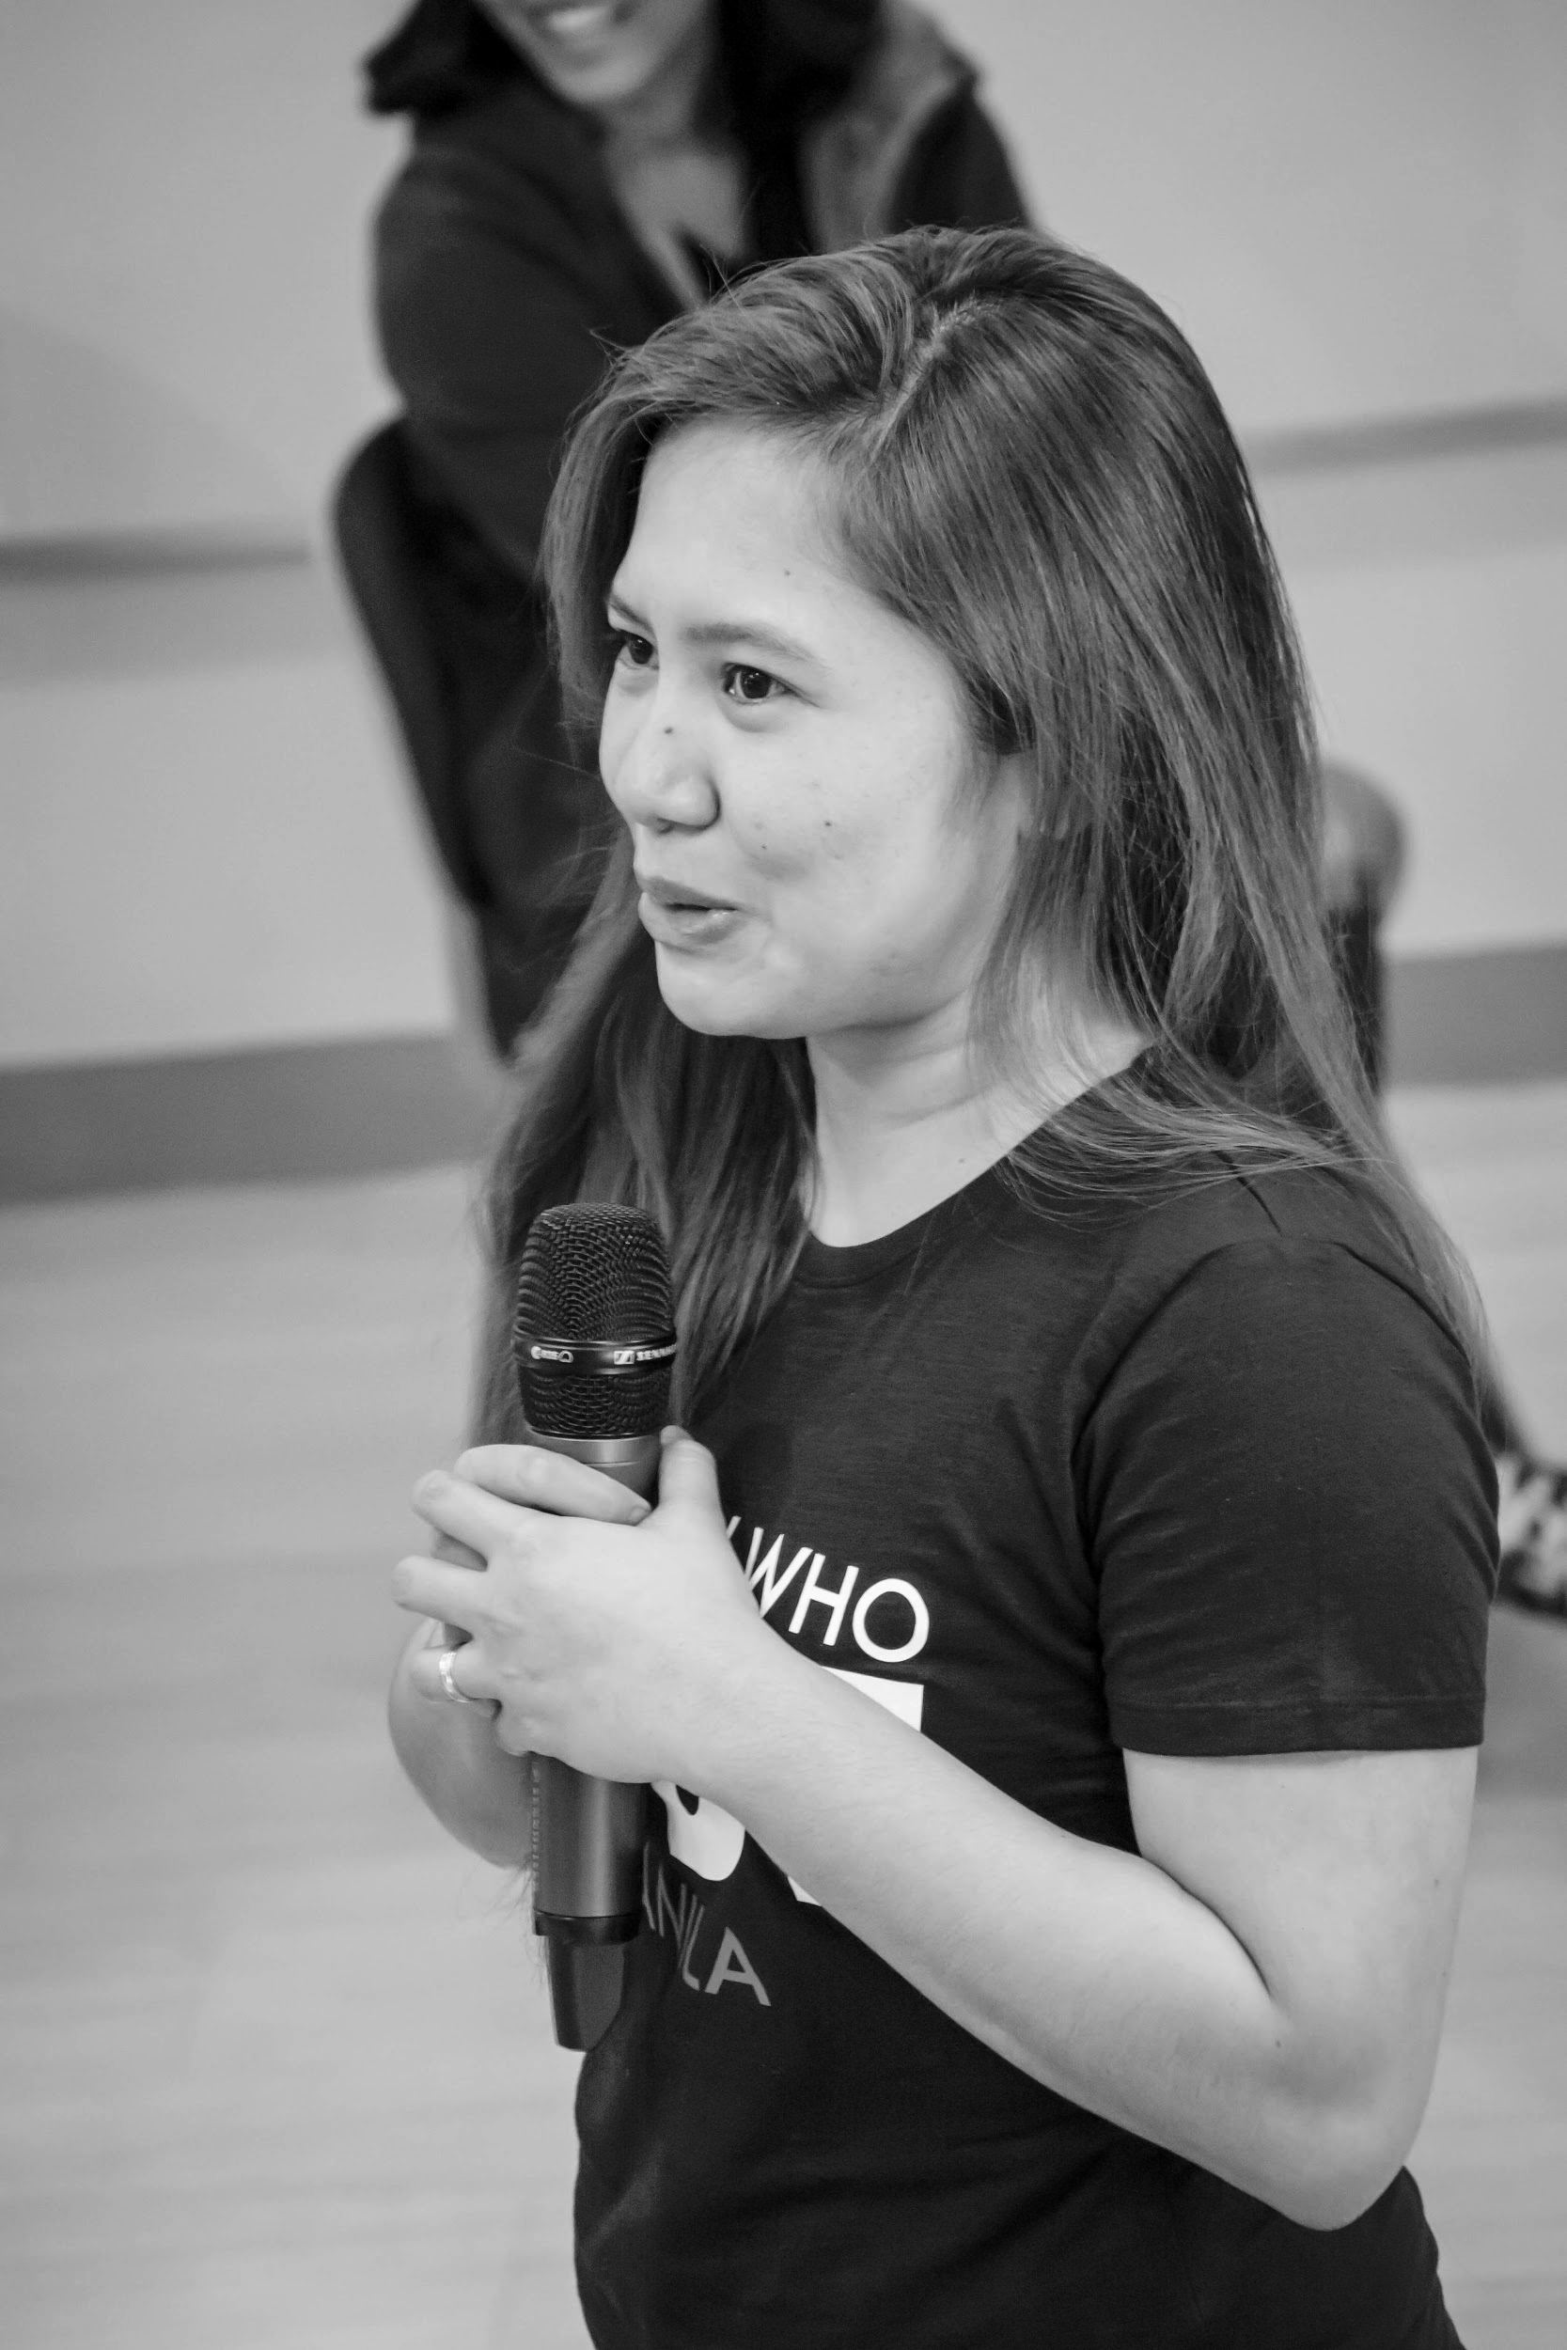
OUR VISION
A world where women are representative as technical executives, founders, VCs, board members and software engineers.

Slide 8
STUDY GROUP
Study groups are events where women can come together and help each other learn and understand a specific programming language, technology, or anything related to coding or engineering.

Slide 9
GUIDELINES
If you have a question, just ask
If you have an idea, share it
Make friends and learn from your study groupmates
Do not recruit or promote your business

Slide 10
SHOW & TELL
Notes:
Please use only the three colors for the content.

Slide 11
LINEAR REGRESSION IN ONE VARIABLE
(a.k.a Univariate Linear Regression)
Notes:
Please use only the three colors for the content.

Slide 12
Agenda
Review
Hypothesis Function
Cost Function
Gradient Descent Algorithm

Slide 13
Review
Supervised vs. Unsupervised

Slide 14
Review
Supervised vs. Unsupervised
Supervised Learning:
Classification – output variables take discrete class labels
Regression – output variable takes continuous values

Slide 15
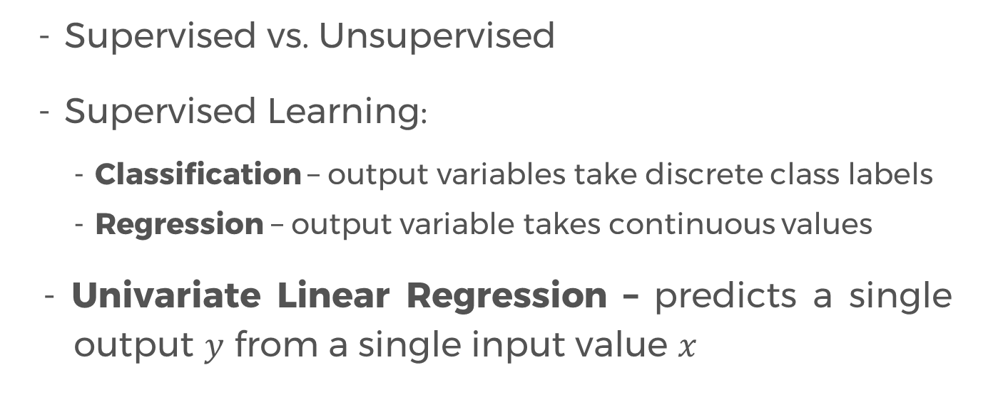
Review
Supervised vs. Unsupervised
Supervised Learning:
Classification – output variables take discrete class labels
Regression – output variable takes continuous values
- Univariate Linear Regression – predicts a single output $y$ from a single input value $x$

Slide 16
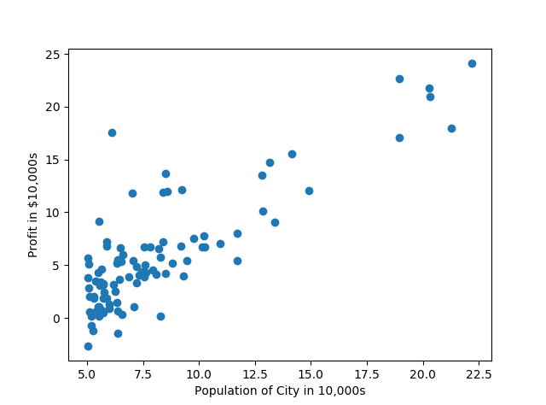
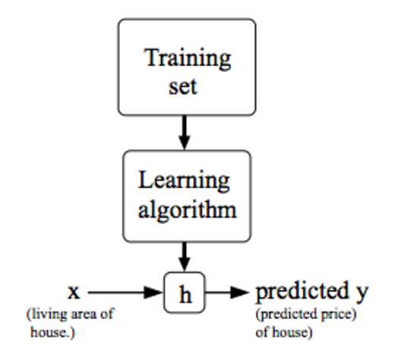
Linear Regression in One Variable
e.g. Predicting Profit of a City
Output/
Class y
Input feature x
Notes:
Please use only the three colors for the content.

Slide 17
Linear Regression
We want to fit a line through the data.
Notes:
Please use only the three colors for the content.

Slide 18
Linear Regression
We want to fit a line through the data.
And make it so that the line generalizes the data well.
Notes:
Please use only the three colors for the content.

Slide 19
Linear Regression
We want to fit a line through the data.
And make it so that the line generalizes the data well.
e.g. If Imus City has a population of about 21k, then its predicted profit is…?
Notes:
Please use only the three colors for the content.

Slide 20
Linear Regression
How do we come up with the “right” line?
Notes:
Please use only the three colors for the content.

Slide 21
Linear Regression
How do we come up with the “right” line?
Notes:
Please use only the three colors for the content.

Slide 22
Linear Regression
How do we come up with the “right” line?
Notes:
Please use only the three colors for the content.

Slide 23
Equation of a Line
Recall the equation of a line?

Slide 24
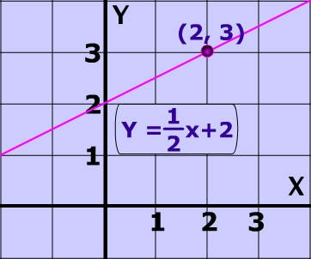
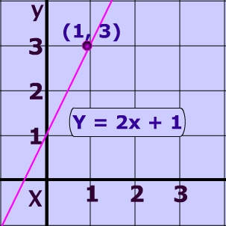
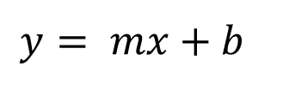
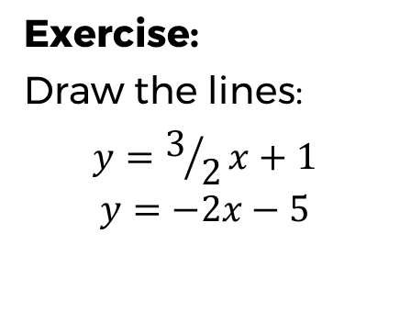
Equation of a Line
Recall the equation of a line?
$$y= mx+b$$
Exercise:
Draw the lines:
$$y=3/2x+1$$
$$y=−2x−5$$

Slide 25
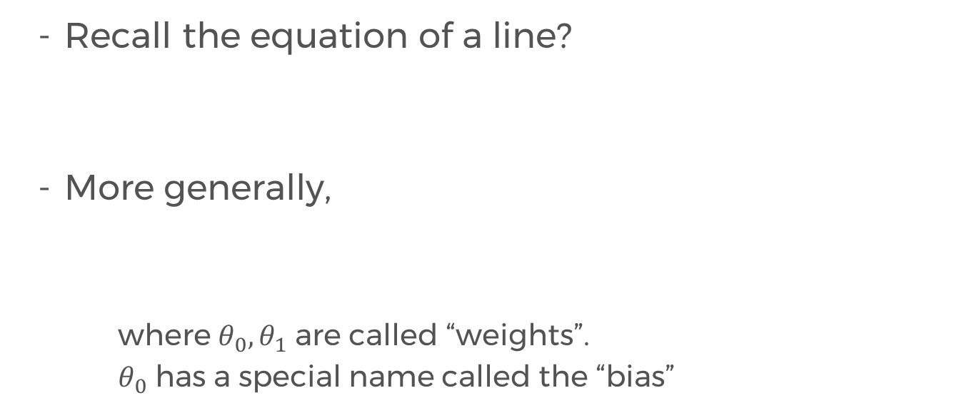
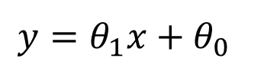
Equation of a Line
Recall the equation of a line?
More generally,
where $θ_{0}, θ_{1}$ are called “weights”.
$θ_{0}$ has a special name called the “bias”
$$y= mx+b$$
$$y=θ_{1}x+θ_{0}$$

Slide 26
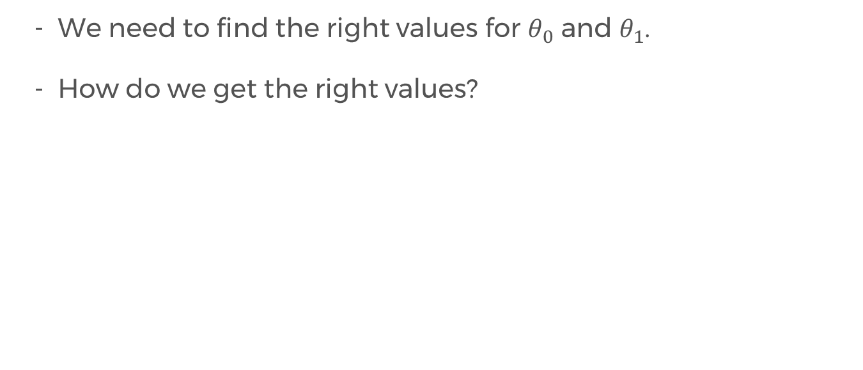
Hypothesis Function
We need to find the right values for $θ_{0}$ and $θ_{1}$.
How do we get the right values?

Slide 27
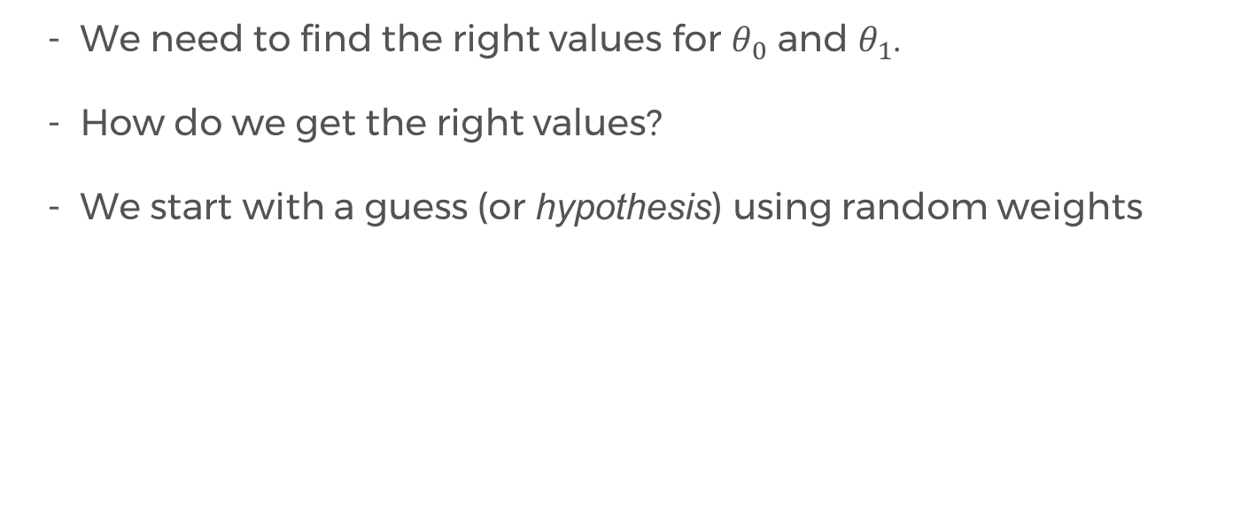
Hypothesis Function
We need to find the right values for $θ_{0}$ and $θ_{1}$.
How do we get the right values?
We start with a guess (or hypothesis) using random weights

Slide 28
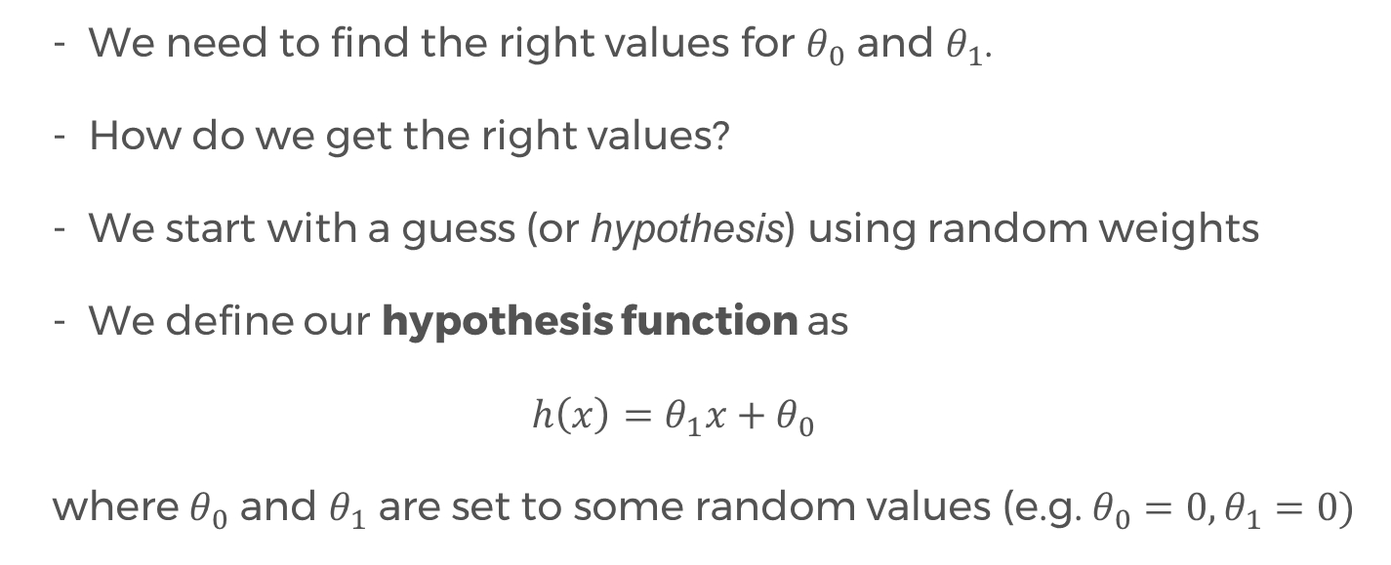
Hypothesis Function
We need to find the right values for $θ_{0}$ and $θ_{1}$.
How do we get the right values?
We start with a guess (or hypothesis) using random weights
We define our hypothesis function as
$$h\left(x\right)=θ_{1}x+θ_{0}$$
where $θ_{0}$ and $θ_{1}$ are set to some random values (e.g. $θ_{0}=0, θ_{1}=0)$

Slide 29
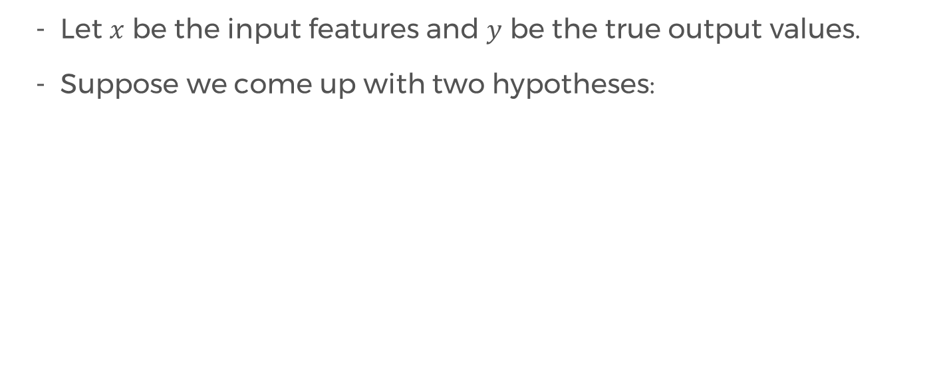
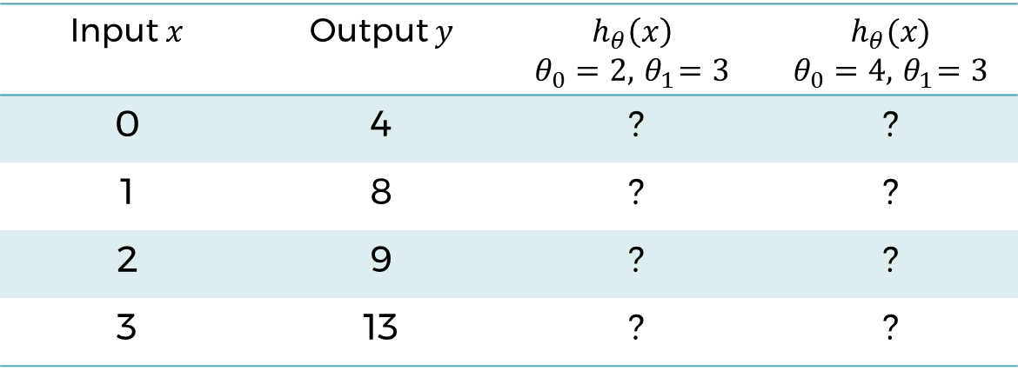
Hypothesis Function
Let $x$ be the input features and $y$ be the true output values.
Suppose we come up with two hypotheses:
Input $x$ | Output $y$ | $$h_{θ}\left(x\right)$$ $$θ_{0}=2, { θ}_{1}=3$$ | $$h_{θ}(x)$$ $$θ_{0}=4, { θ}_{1}=3$$
0 | 4 | ? | ?
1 | 8 | ? | ?
2 | 9 | ? | ?
3 | 13 | ? | ?

Slide 30
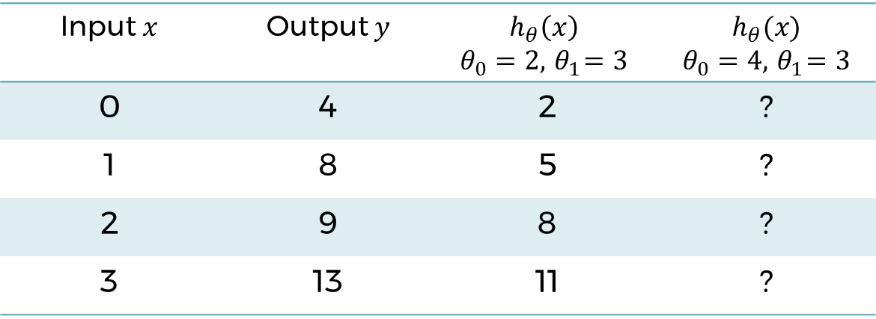
Hypothesis Function
Let $x$ be the input features and $y$ be the true output values.
Suppose we come up with two hypotheses:
Input $x$ | Output $y$ | $$h_{θ}\left(x\right)$$ $$θ_{0}=2, { θ}_{1}=3$$ | $$h_{θ}(x)$$ $$θ_{0}=4, { θ}_{1}=3$$
0 | 4 | 2 | ?
1 | 8 | 5 | ?
2 | 9 | 8 | ?
3 | 13 | 11 | ?

Slide 31
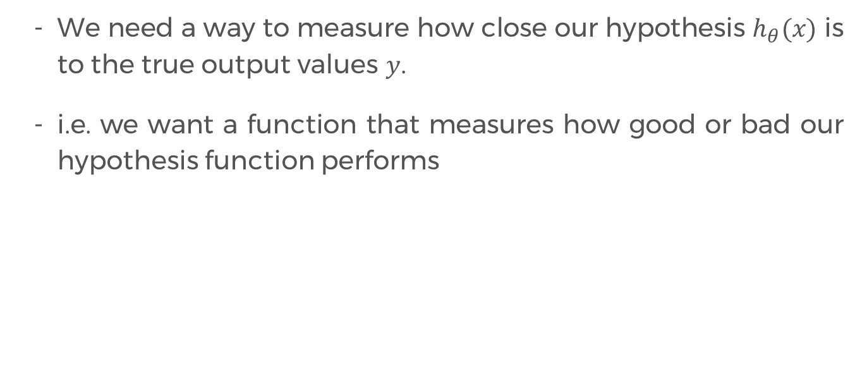
How good is our hypothesis?
We need a way to measure how close our hypothesis $h_{θ}(x)$ is to the true output values $y$.
i.e. we want a function that measures how good or bad our hypothesis function performs

Slide 32
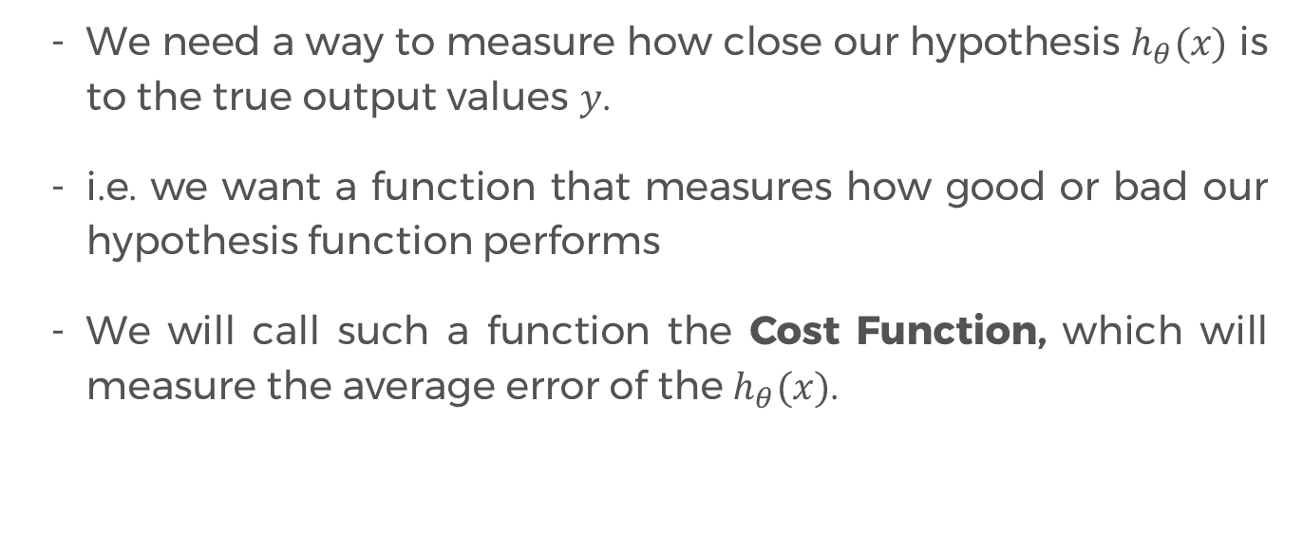
How good is our hypothesis?
We need a way to measure how close our hypothesis $h_{θ}(x)$ is to the true output values $y$.
i.e. we want a function that measures how good or bad our hypothesis function performs
We will call such a function the Cost Function, which will measure the average error of the $h_{θ}(x)$.

Slide 33
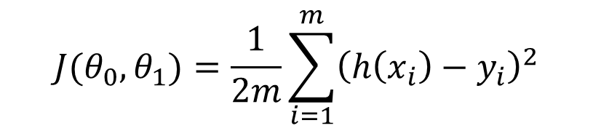
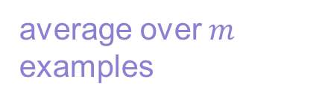

Cost Function
$$J(θ_{0}, θ_{1})=\frac{1}{2m}\sum_{i=1}^{m}{{\left(h\left(x_{i}\right)−y_{i}\right)}^{2}}$$
Cost
“Mean Squared Error (MSE)”
error - we want this to be close to zero
average over $m$ examples
sum over all $m$ examples
Note: The error is squared and the mean is halved as a convenience for computing the gradient descent later.

Slide 34
Minimizing the Cost Function
We want to minimize the cost function, or the mean squared error (MSE).

Slide 35
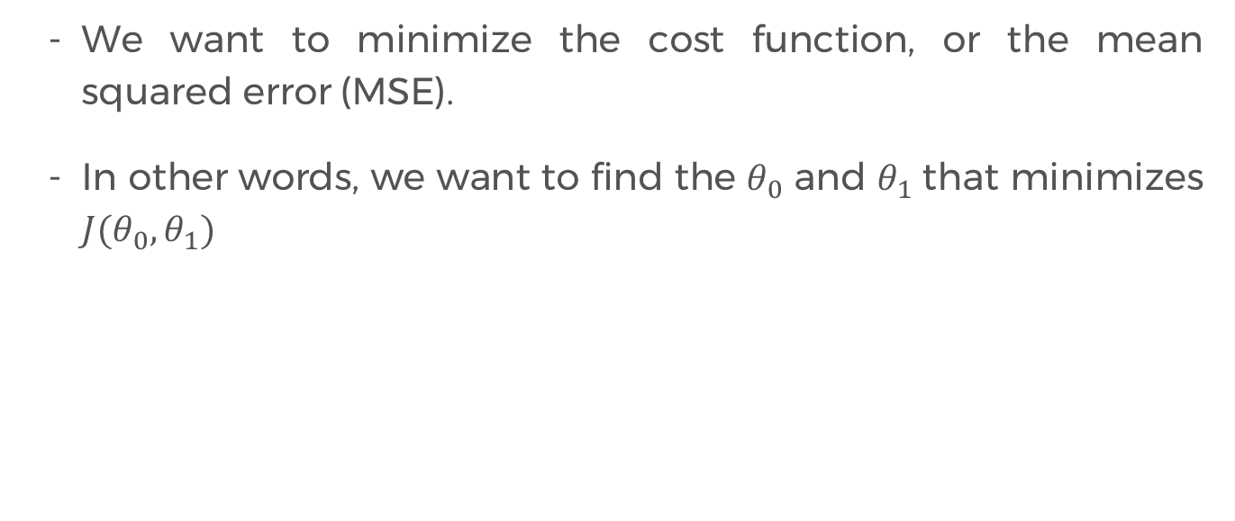
Minimizing the Cost Function
We want to minimize the cost function, or the mean squared error (MSE).
In other words, we want to find the $θ_{0}$ and $θ_{1}$that minimizes $J(θ_{0},θ_{1})$

Slide 36
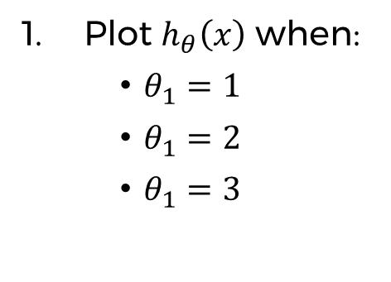
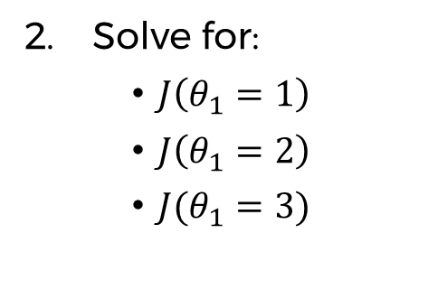
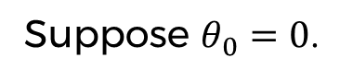
Minimizing the Cost Function
Input x | Output y
0 | 0
1 | 2
2 | 4
3 | 6
Suppose $θ_{0}=0$.
Plot $h_{θ}\left(x\right)$ when:
$θ_{1}=1$
$θ_{1}=2$
$θ_{1}=3$
Solve for:
$J\left(θ_{1}=1\right)$
$J\left(θ_{1}=2\right)$
$J(θ_{1}=3)$

Slide 37
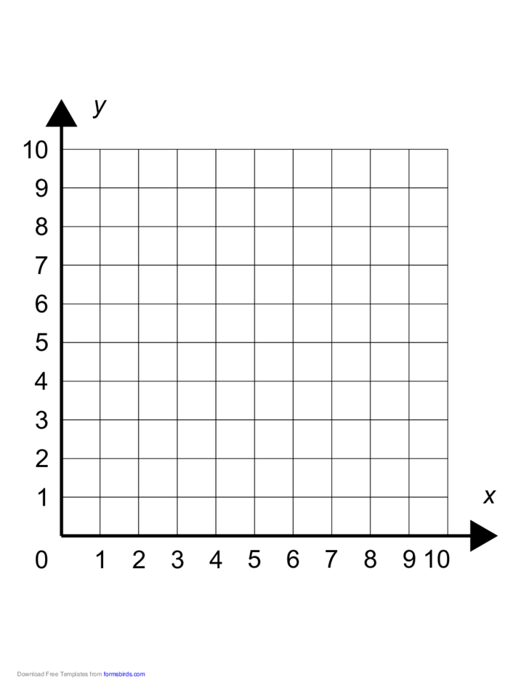
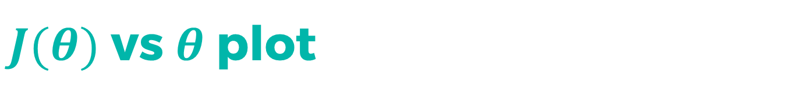
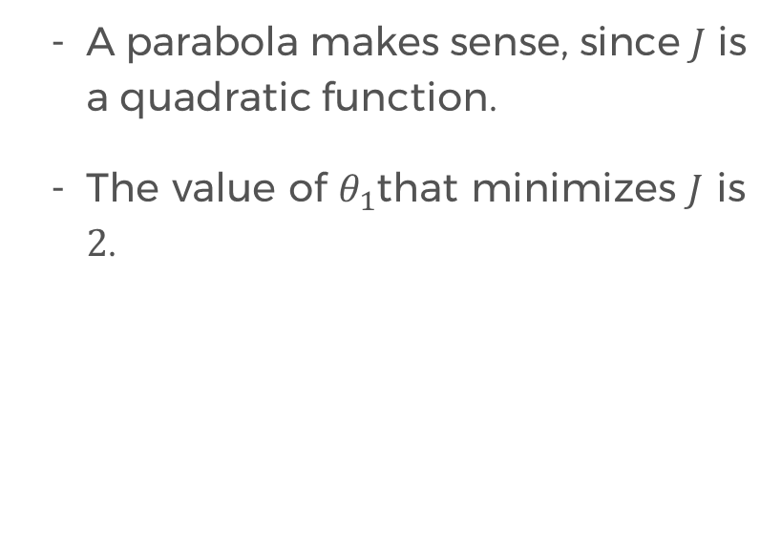
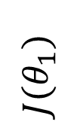
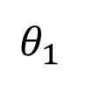
$J(θ)$ vs $θ$ plot
A parabola makes sense, since $J$ is a quadratic function.
The value of $θ_{1}$that minimizes $J$ is $2$.
x
x
$${J(θ}_{1})$$
x
$$θ_{1}$$

Slide 38
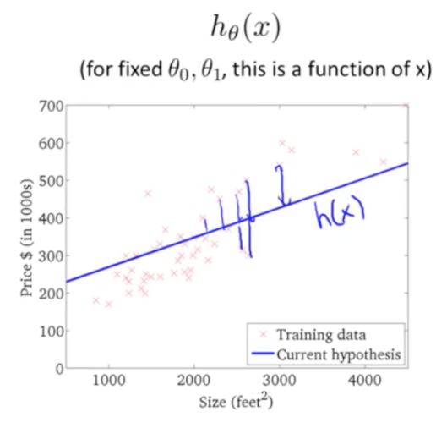
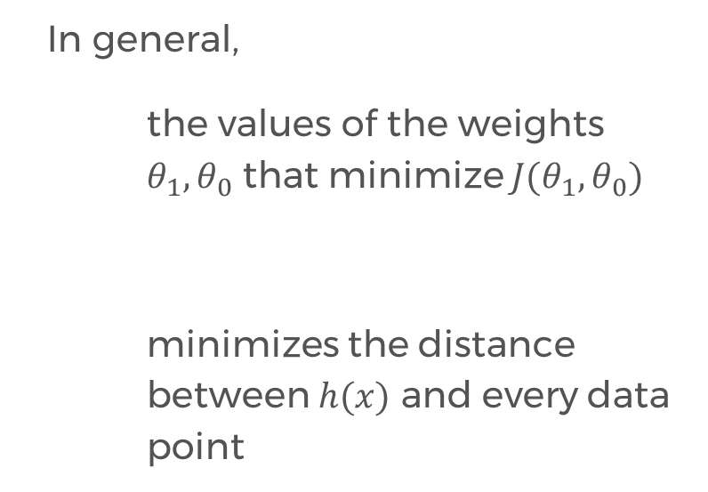
Minimizing J
In general,
the values of the weights $θ_{1},θ_{0}$ that minimize $J(θ_{1},θ_{0})$
minimizes the distance between $h(x)$ and every data point

Slide 39
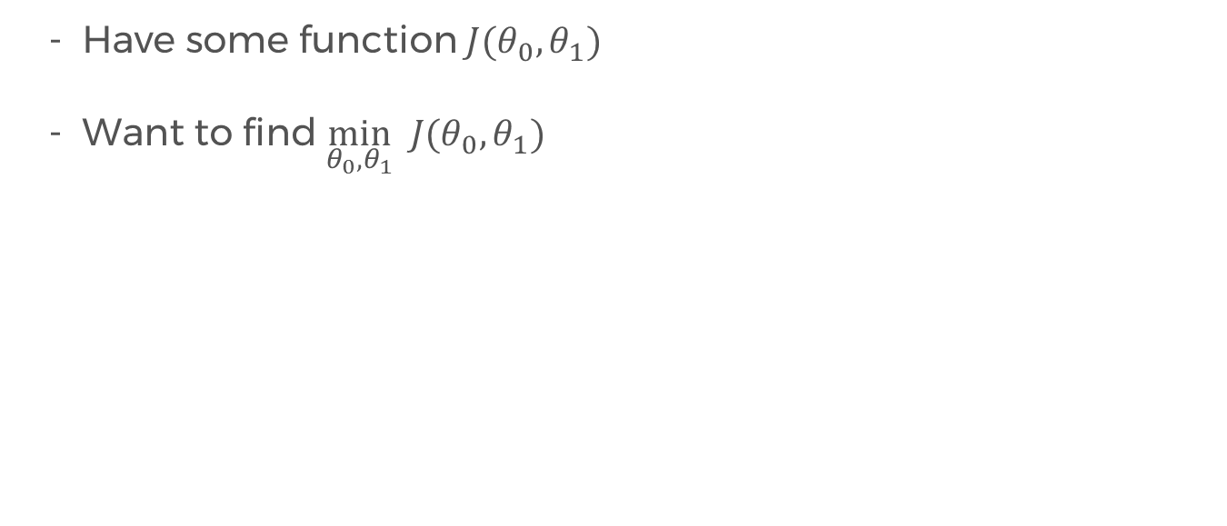
Gradient Descent Algorithm
Have some function $J(θ_{0},θ_{1})$
Want to find $\min_{θ_{0},θ_{1}} J(θ_{0},θ_{1})$

Slide 40
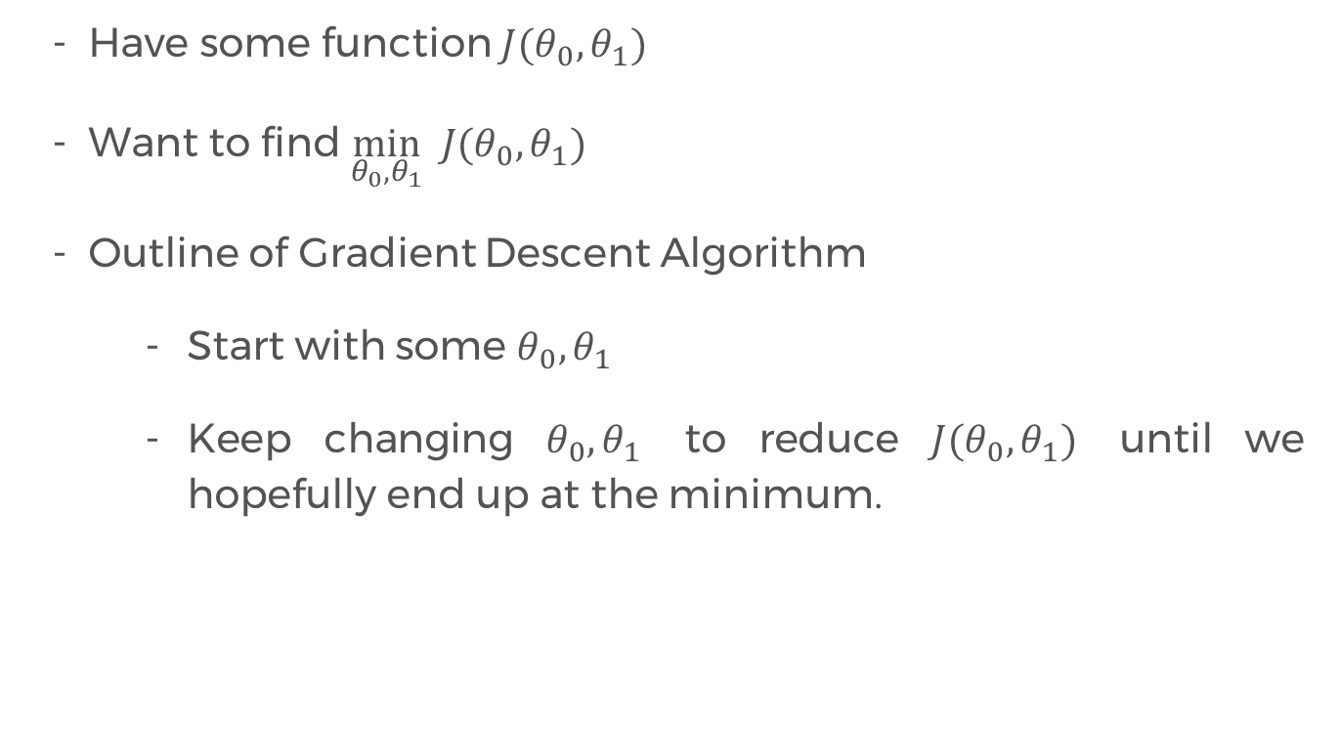
Gradient Descent Algorithm
Have some function $J(θ_{0},θ_{1})$
Want to find $\min_{θ_{0},θ_{1}} J(θ_{0},θ_{1})$
Outline of Gradient Descent Algorithm
Start with some $θ_{0},θ_{1}$
Keep changing $θ_{0},θ_{1}$ to reduce $J(θ_{0},θ_{1})$ until we hopefully end up at the minimum.

Slide 41
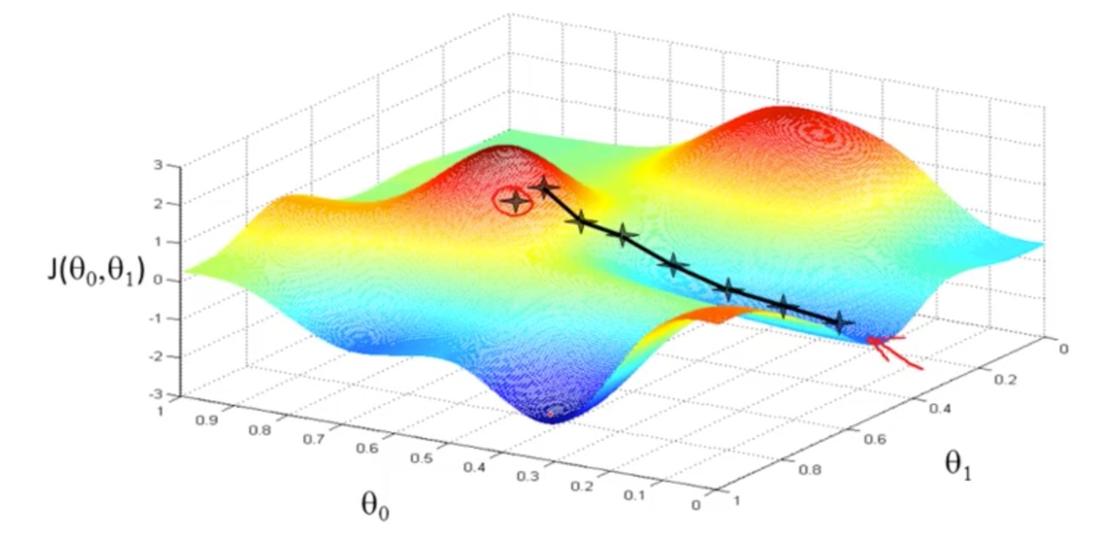
Gradient Descent Algorithm

Slide 42
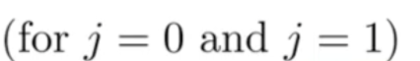
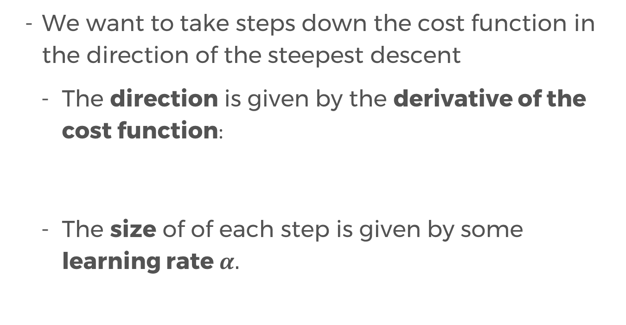
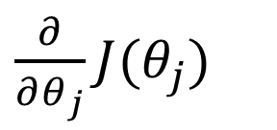
Gradient Descent Algorithm
We want to take steps down the cost function in the direction of the steepest descent
The direction is given by the derivative of the cost function:
The size of of each step is given by some learning rate $α.$
$\frac{∂}{∂θ_{j}}J(θ_{j})$

Slide 43
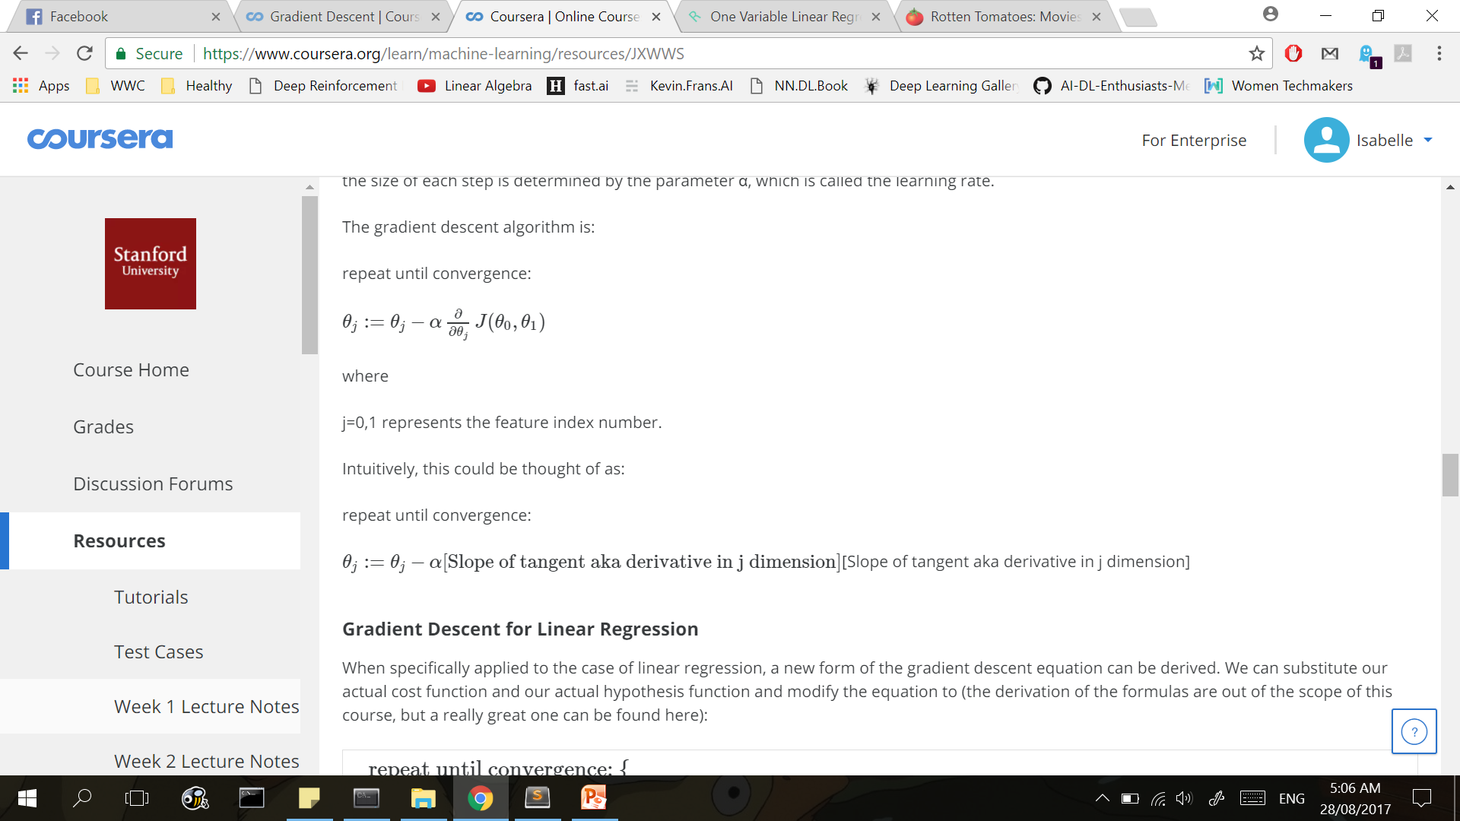
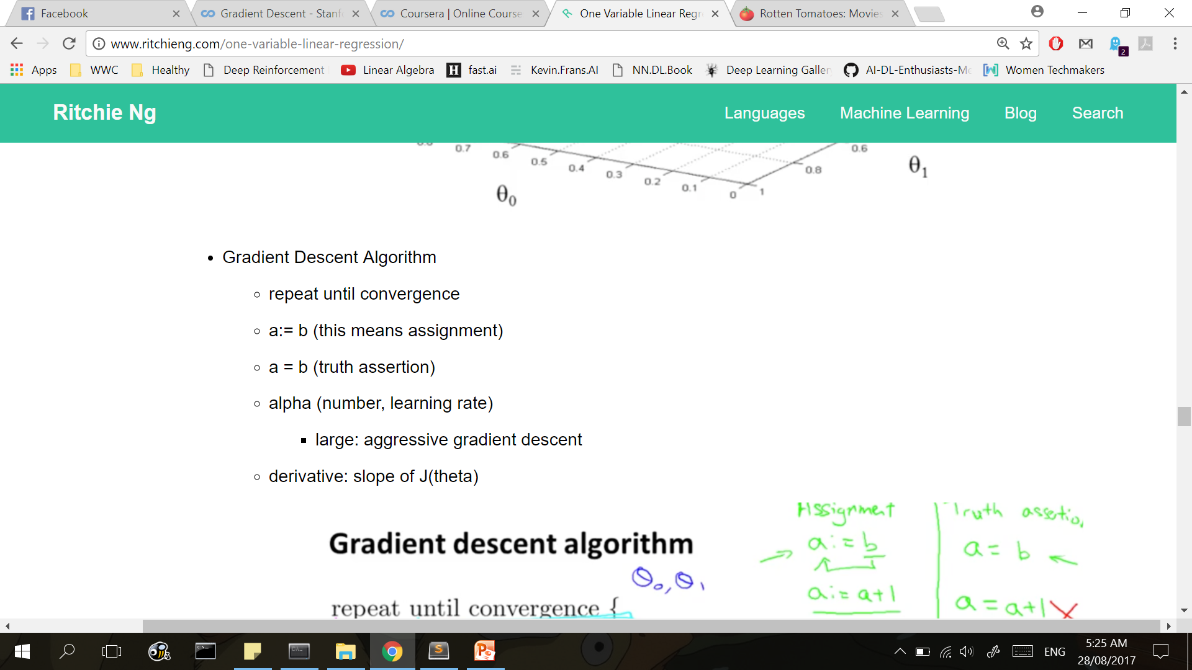
Gradient Descent Algorithm
Derivative of the cost function
(gives the direction of the descent)
Learning rate
(gives the step size of the descent)

Slide 44
Let’s talk about derivatives for a sec.
Notes:
Please use only the three colors for the content.

Slide 45



Derivatives
To get to the minimum value, we take the derivative of our cost function.
Derivative – the slope of the tangent line at a point
x
$${J(θ}_{1})$$
$$\frac{∂}{∂θ_{1}}J(θ_{1})$$
x
x
$$θ_{1}$$

Slide 46
Derivatives
To get to the minimum value, we take the derivative of our cost function.
Derivative – the slope of the tangent line at a point
x
$${J(θ}_{1})$$
$$\frac{∂}{∂θ_{1}}J(θ_{1})$$
x
x
$$θ_{1}$$

Slide 47

Derivatives
What is the slope at the minimum of $J$?
$${J(θ}_{1})$$
x
$$θ_{1}$$

Slide 48


Derivatives
What is the slope at the minimum of $J?$
The slope given by will always be zero!
$$\frac{∂}{∂θ_{1}}J(θ_{1})$$
$${J(θ}_{1})$$
x
$$θ_{1}$$

Slide 49



Covergence
We say that our algorithm has converged when
$θ_{1}$ ceases to update to a new value.
$$\frac{∂}{∂θ_{1}}J\left(θ_{1}\right)=0$$
$${J(θ}_{1})$$
$$θ_{1}:=θ_{1}−α(0)$$
x
$$θ_{1}$$

Slide 50

Derivative Intuition

Slide 51

Learning Rate Intuition

Slide 52

Gradient Descent Algorithm

Slide 53

Gradient Descent Algorithm

Slide 54

Gradient Descent Algorithm

Slide 55
Partner/Group/Individual Exercise
Notes:
Please use only the three colors for the content.

Slide 56
Partner/Group/Individual Presentation
Notes:
Please use only the three colors for the content.

Slide 57
References
Notes:
Please use only the three colors for the content.

Slide 58
T.I.L.
SHARE IT!
In front!
On Twitter: @wwcodemanila
Or FB: fb.com/wwcodemanila
Don’t forget to tag WWCodeManila so we can retweet or share it.
Notes:
Please use only the three colors for the content.

Slide 59
Feedback Form
https://goo.gl/YzSqcS
Please don’t rate the event on meetup.
Not helpful. It is best to just tell your concerns via the feedback form. We are a building a community not a Yelp restaurant.
Notes:
Please use only the three colors for the content.

Slide 60
THANK YOU :)
Notes:
Please use only the three colors for the content.

